Slide 1

TAKSHASHILA INSTITUTE OF ENGINEERING & TECHNOLOGY, DARAPUR
Seminar Presentation
on
“AI-POWERED HAND GESTURE CONTROLLED ROBOT ”
Presented by
VINAY MESHRAM
PRANIT BONDE
ABHISHEK GAWANDE
SANSKRUTI KADAM
Guide
Prof. T.N.GHORSAD
Submitted to Sant Gadge Baba Amravati University,
Amravati in partial fulfillment of the requirements for the award of degree
BACHELOR OF ENGINEERING
in
COMPUTER SCIENCE AND ENGINEERING

Slide 2
AI - Powered Hand Gesture Controlled
Robot
This presentation covers the design of an AI-powered robot controlled by hand gestures, using an accelerometer, Arduino, and motor driver.

Slide 3
Table of Contents
Project Objectives
System Overview
Hardware and Software Design
Testing & Results
Advantages
Real-Life Applications
Future Enhancements
Conclusion and Future Prospects

Slide 4
Project Objectives
Primary Goal : Develop a robot that responds to hand gestures in real-time.
Design reliable gesture recognition
Integrate accelerometer data with Arduino.
Implement precise motor control.
Evaluate system performance.
Key Objectives :

Slide 5
System Overview
Key Components :
Accelerometer: Detects hand tilt in three axes.
Arduino: Processes data from the accelerometer.
Motor Driver (L293D): Controls the robot's movement.
Robot Chassis: Provides structure and mobility.
System Flow :
Gesture input → Data processing → Motor control → Robot action.

Slide 6

Hardware and Software Design
Hardware Integration:
Accelerometer for hand gesture detection.
Arduino Uno for data processing and motor control.
Motor Driver for managing robot movement.
Software:
Arduino code processes accelerometer data and controls movement actions (forward, backward, left, right, stop).

Slide 7

Testing & Results
Key Testing Parameters:
Gesture Accuracy: Tests for forward, backward, left, right, and stop gestures.
Response Time: Less than 0.5 seconds delay.
Environmental Conditions: Tested under various lighting and vibrations.
Results:
100% gesture recognition accuracy.
Real-time performance with minimal latency.

Slide 8
Advantages
Hand-free Operations : No need for physical controls.
Real-time Response: Instant feedback to user gestures.
Accessibility: Ideal for individuals with physical disabilities.
Cost-Effective: Uses low-cost components (Arduino, L293D motor driver, accelerometer).

Slide 9

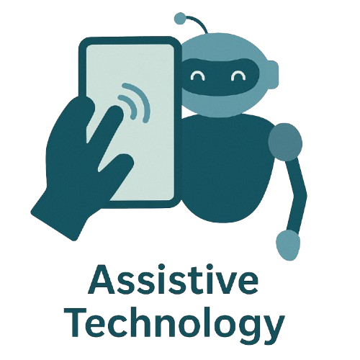


Real-Life Applications
Assistive Technology: Gesture control for individuals with disabilities.
Industrial Automation: Used in factories for controlling robots without physical interfaces.
Military & Defense: Gesture-controlled robots for bomb detection and reconnaissance.
Rescue Operations: Gesture control for robots in hazardous environments.

Slide 10

Future Enhancements
🎙️ Voice Control Integration Enable dual-mode interaction using voice and hand gestures for seamless control.
🖐️ Enhanced Gesture Recognition Improve accuracy and expand gesture library with advanced AI models.
⚙️ Broader Applications Extend usability to healthcare, gaming, industrial automation, and education.
📡 Smart Sensor Upgrades Integrate advanced sensors to detect obstacles and improve navigation fluidity.

Slide 11
Conclusion and Future Prospects
Conclusion:
AI-powered hand gesture control enhances human-robot interaction.
Demonstrates real-time control and intuitive operation.
Future Work :
Advanced Gesture Recognition: Support complex movements like diagonal gestures.
Sensor Fusion: Combine accelerometer with other sensors for better accuracy.

Slide 12
THANK YOU!

Slide 13

THANK YOU!
Any Questions ?

